Slide 1
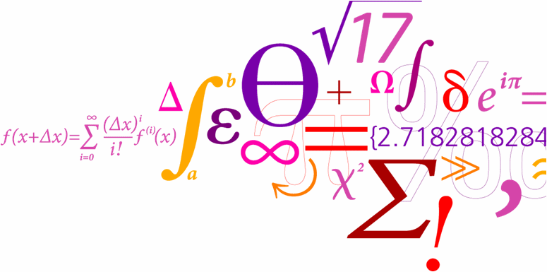
Triple negative breast cancer
Thomas Leicht Jensen

Slide 2
Contents
Introduction
Data
Unsupervised clustering methods
Metrics
K-means clustering
DCEC
Clustering analysis
Clustering distribution
Survival analysis
Results
Future work and conclusion

Slide 3
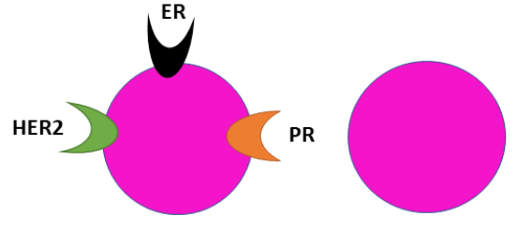
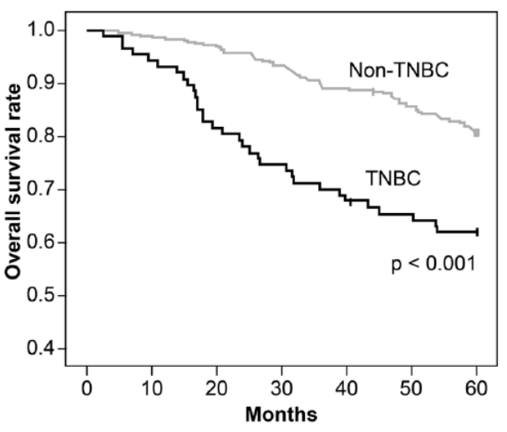
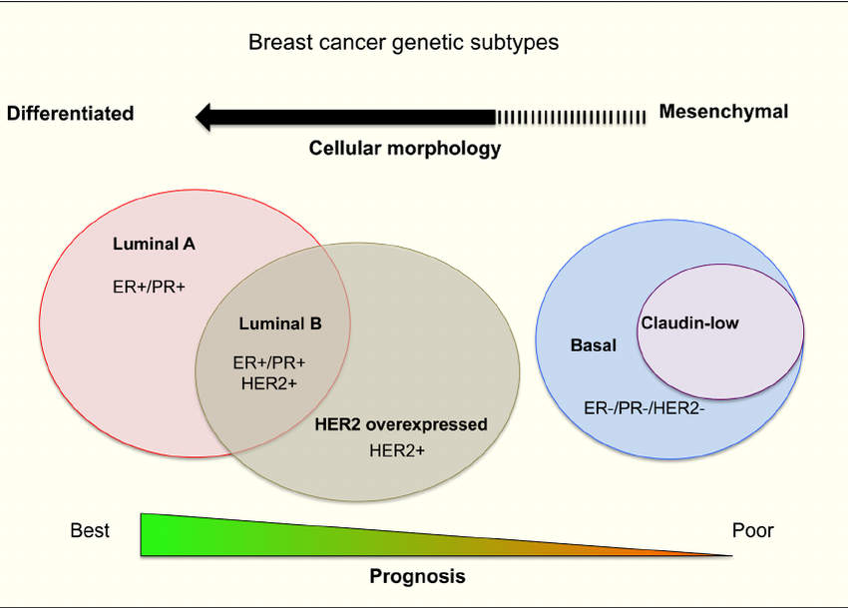
Triple negative breast cancer
Triple negative breast cancer:
About 16% of breast cancers
Lack estrogene, progesterone receptors and HER2 over expression.
5-year survival
TNBC: 62%
non-TNBC: 81%
Gonçalves et al. 2018 Clin. Med insight: oncology.
Benjamin Heng et al. Oncotarget 2015

Slide 4
TNBC subtypes
Genetic subtyping of breast cancer
PAM50: 50 gene expressions
Luminal A
Luminal B
HER2 enriched
Basal-like
Normal-like
Histological subtyping of TNBC
Lehmann: 4 histological expressions
Basal-like 1
Basal-like 2
Mesenchymal
Luminal androgen Receptor

Slide 5
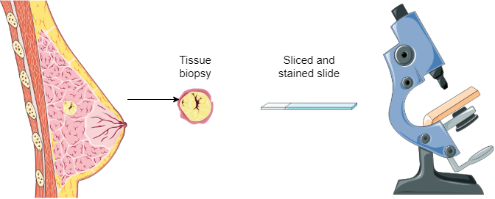
Cancer diagnosis
Cancer diagnosis and treatment is based on tissue biopsy.
Procedure is time consuming and complex.
Histopathological image analysis seeks to help pathologist:
Make efficient and appropriate diagnoses
Guide treatment
Tumor stage diagnosis
Stage I
Stage II
Stage III

Slide 6
Research goal
Goal: Identify morphological TNBC patterns to aid pathologist in treatment and diagnosis.
Implement and evaluate unsupervised learning algorithms to cluster TNBC tiles.
Relate clustering outcome to existing subtypes:
PAM50
Lehmann histology
Tumor and neoplasm stages
Use survival modelling to predict patient outcomes.

Slide 7
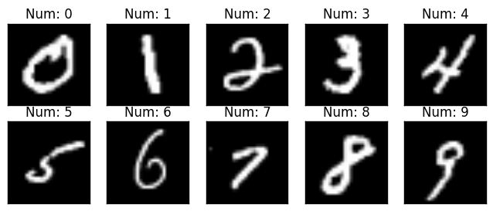
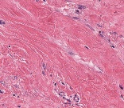
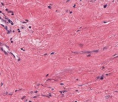
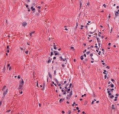
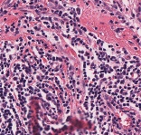
Data
MNIST
Tissues
Tumor
Classes: Digits 0:9
Train: 60,000
Test: 10,000
Size: [1 x 28 x 28]
Classes: Fat, stroma, lymphocytes and tumor
Train: 7,847
Test: 1,989
Size: [3 x 128 x 128], 20X
No classes
N=98 patient slides
79 right censoring, 19 events
Size: [3 x 128 x 128], 20X
Dataset | # Images | Classes | Dimension
MNIST | 70,000 | 10 | 784
Tissues | 9,836 | 4 | 49,152
Tumor | 426,642 | NA | 49,152

Slide 8
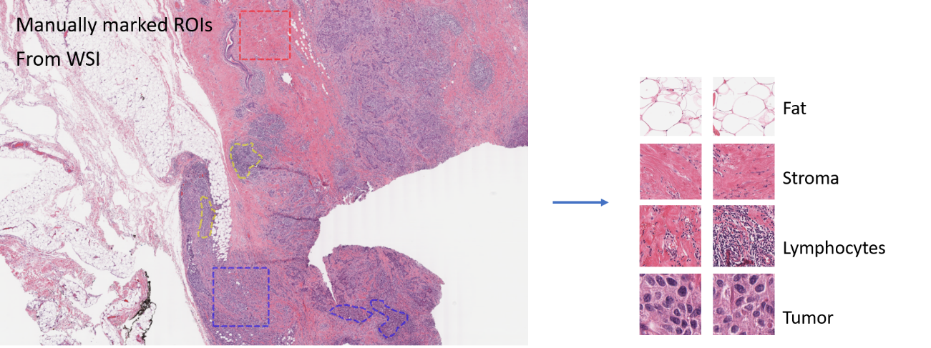
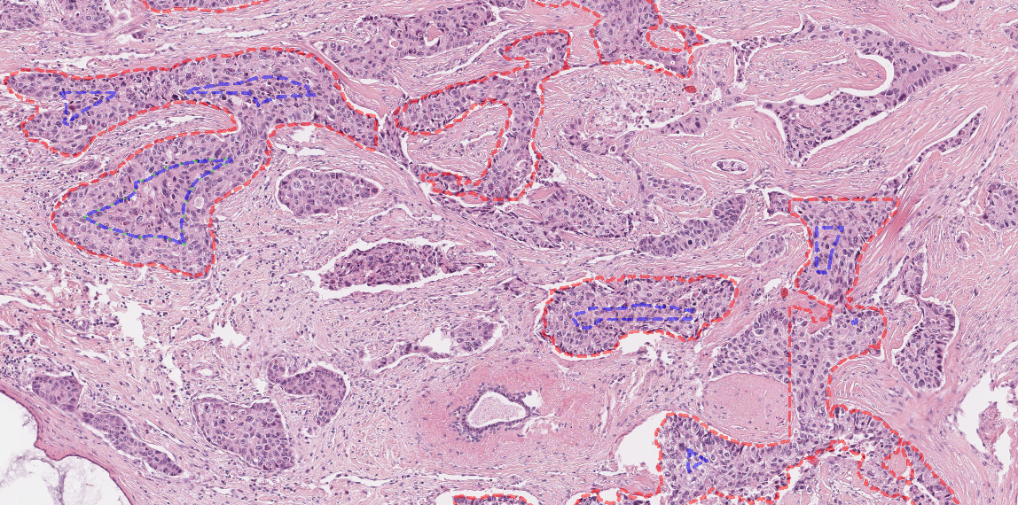
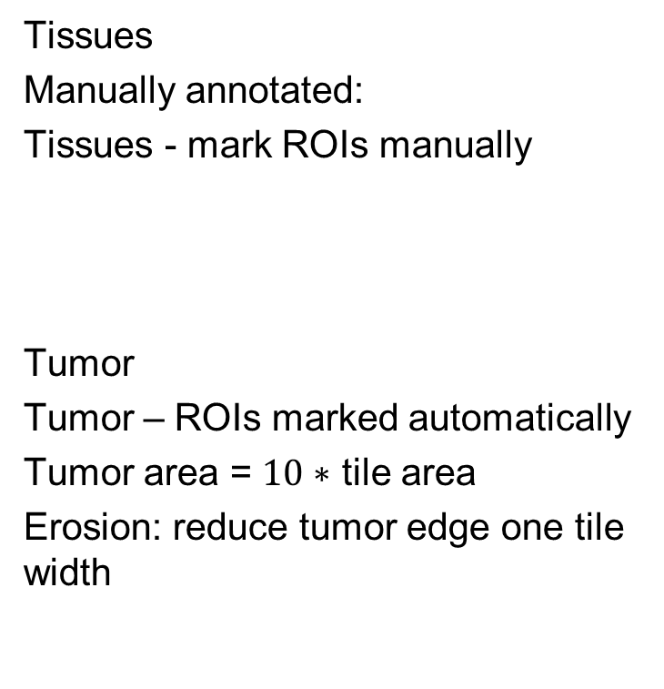
Tile extraction of the datasets
Tissues
Manually annotated:
Tissues - mark ROIs manually
Tumor
Tumor – ROIs marked automatically
Tumor area = $10∗$ tile area
Erosion: reduce tumor edge one tile width

Slide 9
Clustering methods
Baseline: Use MNIST and Tissues datasets to benchmark best clustering method:
Naive K-means: Convolutional autoencoder (CAE) + K-means clustering
DCEC: Deep convolutional embedded clustering
Evaluate with external metrics
Tumor: Identify best model to cluster tumor tiles.
Evaluate with internal metrics
External: Score comparing ground truth and predicted labels.
Normalized mutual information (NMI), Adjusted rand index (ARI) and clustering accuracy (ACC).
Internal: Unsupervised scoring of between and inter-clusters dispersion.
Calinski-Harabasz Index (CHI), Silhouette coefficient (SSE) and Davies (Bouldin Index (DBI).
External | NMI 0: no mutual information, 1: perfect correlation | ARI 0: random 1: perfect labeling | ACC Clustering accuracy
Internal | CHI ↑ maximize | SSE Close to 1 | DBI ↓ minimize

Slide 10
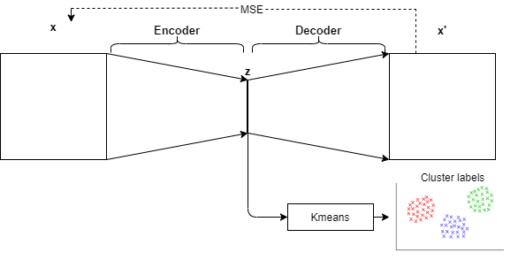
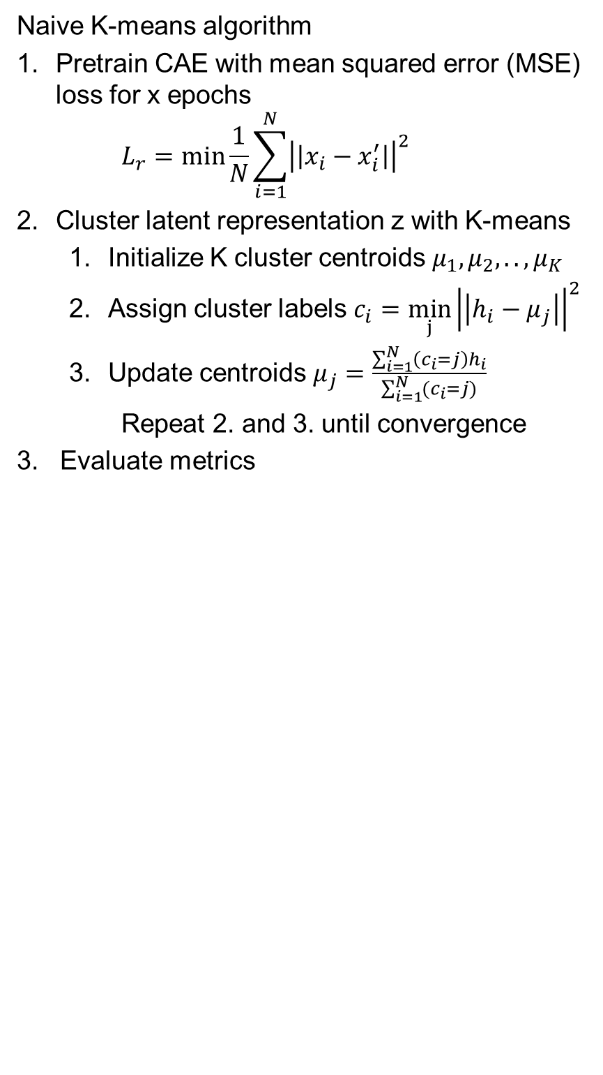
Clustering methods Naive K-means
Naive K-means algorithm
Pretrain CAE with mean squared error (MSE) loss for x epochs
$$L_{r}=\min{\frac{1}{N}}\sum_{i=1}^{N}{{\left|\left|x_{i}−x_{i}^{′}\right|\right|}^{2}}$$
Cluster latent representation z with K-means
Initialize K cluster centroids $μ_{1},μ_{2}, .., μ_{K}$
Assign cluster labels $c_{i}=\min_{j}{{\left|\left|h_{i}−μ_{j}\right|\right|}^{2}}$
Update centroids $μ_{j}=\frac{\sum_{i=1}^{N}{\left(c_{i}=j\right)h_{i}}}{\sum_{i=1}^{N}{(c_{i}=j)}}$
Repeat 2. and 3. until convergence
3. Evaluate metrics
Naive K-means

Slide 11
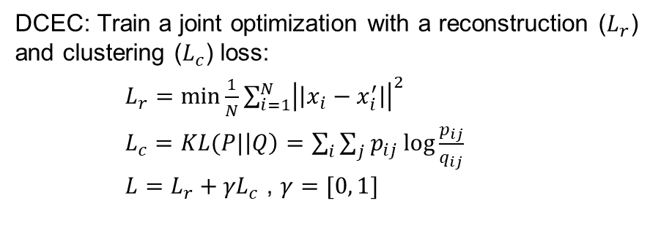
Clustering methods DCEC
DCEC: Train a joint optimization with a reconstruction ($L_{r}$) and clustering ($L_{c}$) loss:
$L_{r}=\min{\frac{1}{N}}\sum_{i=1}^{N}{{\left|\left|x_{i}−x_{i}^{′}\right|\right|}^{2}}$
$L_{c}=KL(P|\left|Q\right)=\sum_{i}{\sum_{j}{p_{ij}\log{\frac{p_{ij}}{q_{ij}}}}}$ $L=L_{r}+{γL}_{c}$ , $γ=[0, 1]$
Guo et al. LNCS 373-382. 2017

Slide 12
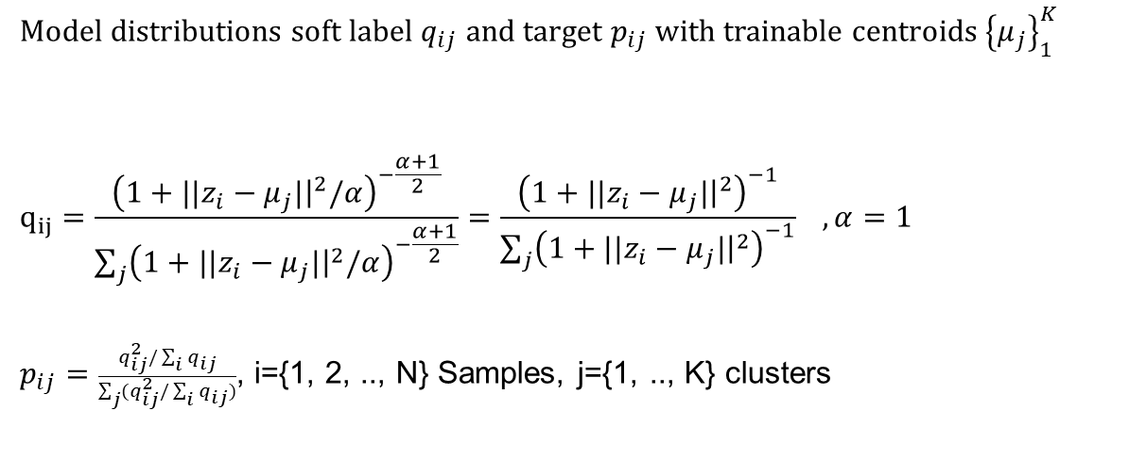
Clustering methods DCEC
DCEC: Train a joint optimization with a reconstruction ($L_{r}$) and clustering ($L_{c}$) loss:
$L_{r}=\min{\frac{1}{N}}\sum_{i=1}^{N}{{\left|\left|x_{i}−x_{i}^{′}\right|\right|}^{2}}$
$L_{c}=KL(P|\left|Q\right)=\sum_{i}{\sum_{j}{p_{ij}\log{\frac{p_{ij}}{q_{ij}}}}}$ $L=L_{r}+{γL}_{c}$ , $γ=[0, 1]$
Model distributions soft label $q_{ij}$ and target $p_{ij}$ with trainable centroids ${\left\{μ_{j}\right\}}_{1}^{K}$
$$q_{ij}=\frac{{\left(1+||z_{i}−μ_{j}|{\left.​\right|}^{2}/α\right)}^{−\frac{α+1}{2}}}{\sum_{j}{{\left(1+||z_{i}−μ_{j}|{\left.​\right|}^{2}/α\right)}^{−\frac{α+1}{2}}}}=\frac{{\left(1+||z_{i}−μ_{j}|{\left.​\right|}^{2}\right)}^{−1}}{\sum_{j}{{\left(1+||z_{i}−μ_{j}|{\left.​\right|}^{2}\right)}^{−1}}} , α=1$$
$p_{ij}=\frac{q_{ij}^{2}/\sum_{i}{q_{ij}}}{\sum_{j}{(q_{ij}^{2}/\sum_{i}{q_{ij}})}}$, i={1, 2, .., N} Samples, j={1, .., K} clusters
Guo et al. LNCS 373-382. 2017
Euclidean
Soft label
Target

Slide 13
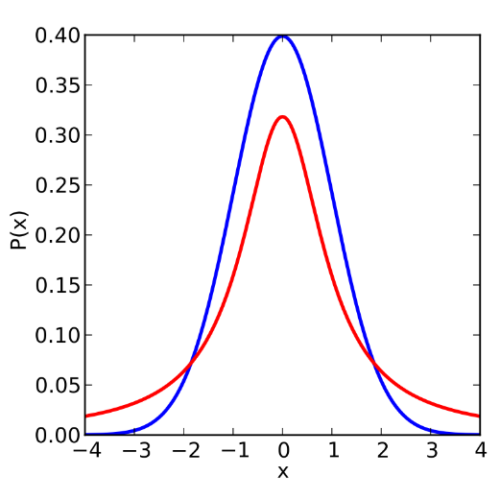
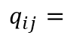
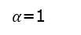
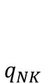
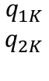
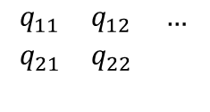
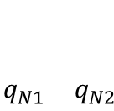
Clustering methods DCEC
DCEC: Train a joint optimization with a reconstruction ($L_{r}$) and clustering ($L_{c}$) loss:
$L_{r}=\min{\frac{1}{N}}\sum_{i=1}^{N}{{\left|\left|x_{i}−x_{i}^{′}\right|\right|}^{2}}$
$L_{c}=KL(P|\left|Q\right)=\sum_{i}{\sum_{j}{p_{ij}\log{\frac{p_{ij}}{q_{ij}}}}}$ $L=L_{r}+{γL}_{c}$ , $γ=[0, 1]$
Model distributions soft label $q_{ij}$ and target $p_{ij}$ with trainable centroids ${\left\{μ_{j}\right\}}_{1}^{K}$
$$q_{ij}=\frac{{\left(1+||z_{i}−μ_{j}|{\left.​\right|}^{2}/α\right)}^{−\frac{α+1}{2}}}{\sum_{j}{{\left(1+||z_{i}−μ_{j}|{\left.​\right|}^{2}/α\right)}^{−\frac{α+1}{2}}}}=\frac{{\left(1+||z_{i}−μ_{j}|{\left.​\right|}^{2}\right)}^{−1}}{\sum_{j}{{\left(1+||z_{i}−μ_{j}|{\left.​\right|}^{2}\right)}^{−1}}} , α=1$$
$p_{ij}=\frac{q_{ij}^{2}/\sum_{i}{q_{ij}}}{\sum_{j}{(q_{ij}^{2}/\sum_{i}{q_{ij}})}}$, i={1, 2, .., N} Samples, j={1, .., K} clusters
Guo et al. LNCS 373-382. 2017
K clusters
0 … K
Euclidean
N(0,1)
1
N
Soft label
Standard normal
$$\begin{matrix}q_{11} & q_{12} & … \\ q_{21} & q_{22} & \\ & & \end{matrix}$$
$$\begin{matrix}q_{1K} \\ q_{2K} \\ \end{matrix}$$
$$q_{ij}=$$
…
Target
$$\begin{matrix} & & \\ & & \\ q_{N1} & q_{N2} & \end{matrix}$$
$$\begin{matrix} \\ \\ q_{NK}\end{matrix}$$
$α$=1
Student-t distribution

Slide 14
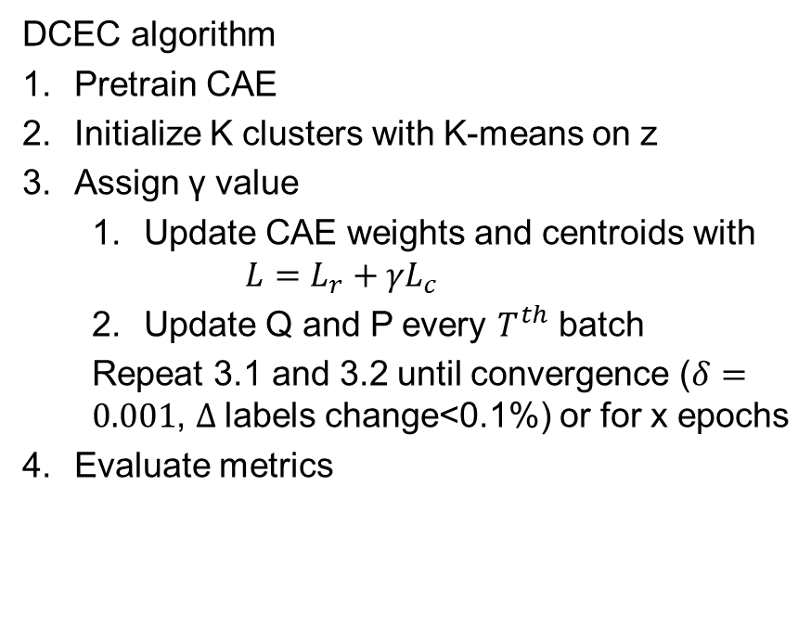
Clustering methods DCEC
DCEC algorithm
Pretrain CAE
Initialize K clusters with K-means on z
Assign γ value
Update CAE weights and centroids with
$$L=L_{r}+{γL}_{c}$$
Update Q and P every $T^{th}$ batch
Repeat 3.1 and 3.2 until convergence ($δ=0.001$, $Δ$labels change<0.1%) or for x epochs
Evaluate metrics
…
Guo et al. LNCS 373-382. 2017
KL divergence is low when Q and P are similar

Slide 15
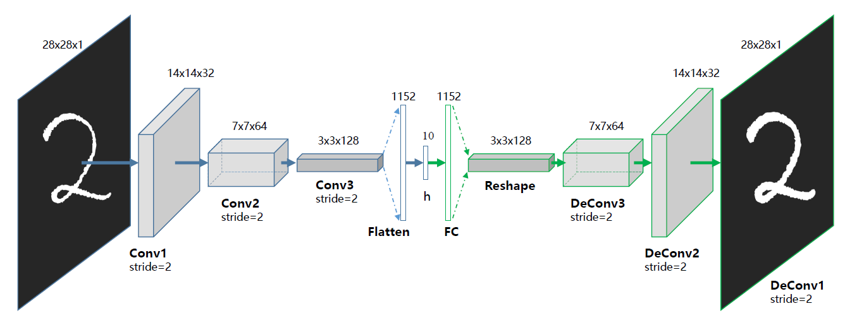
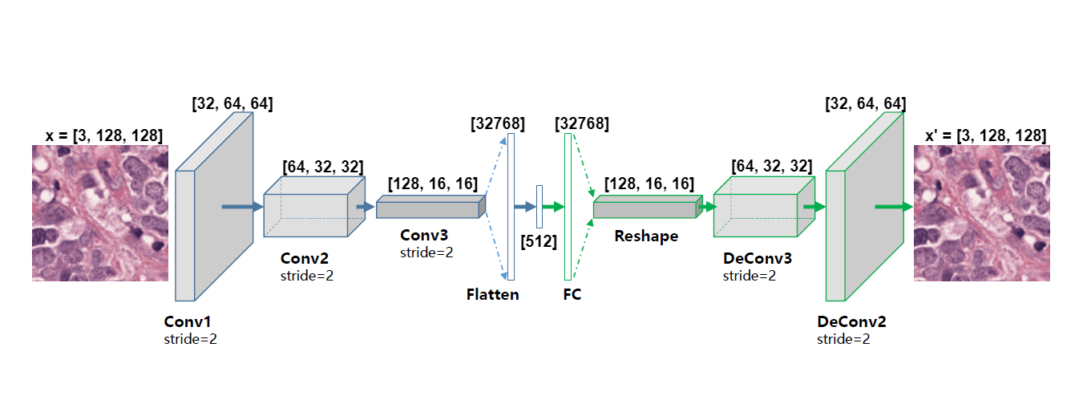
CAE architectures
MNIST
Guo et al. LNCS 373-382. 2017
Tissues and Tumor

Slide 16
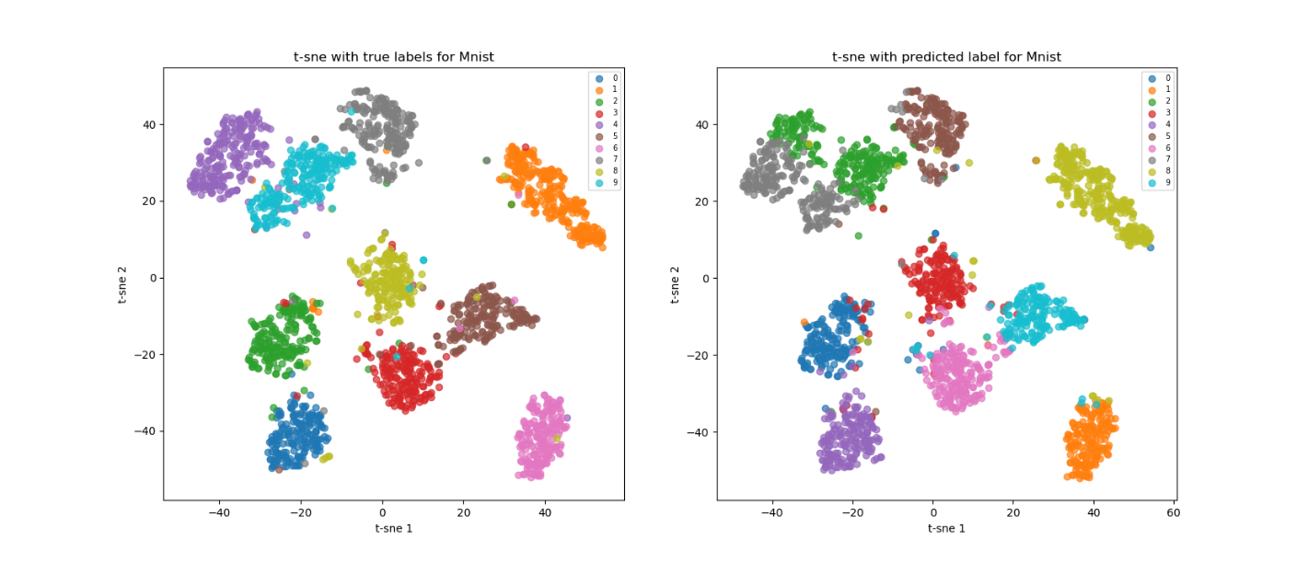
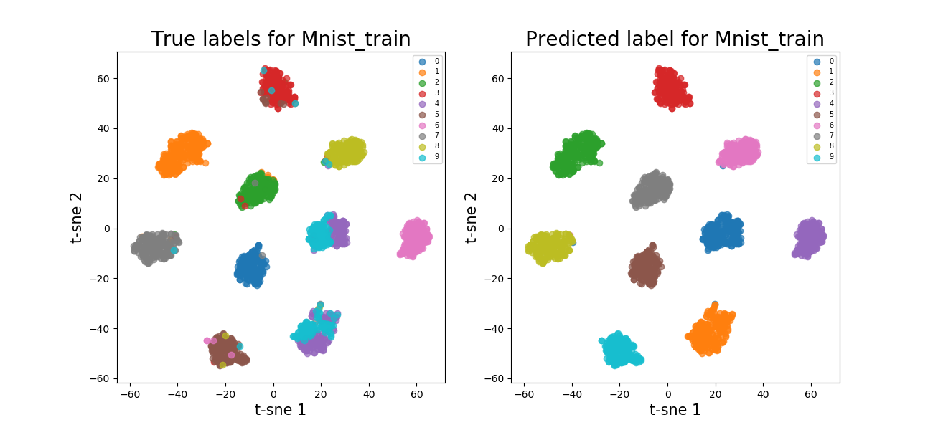
Baseline results MNIST
4+9
DCEC higher external metrics and tightly bound clusters
Overlap between 4 and 9
Naive K-means
Method, partition | NMI | ARI | ACC
Naive K-means, train | 0.77 | 0.73 | 0.84
Naive K-means, test | 0.79 | 0.75 | 0.86
DCEC, train | 0.87 | 0.84 | 0.88
DCEC, test | 0.88 | 0.84 | 0.88
DCEC
4+9

Slide 17
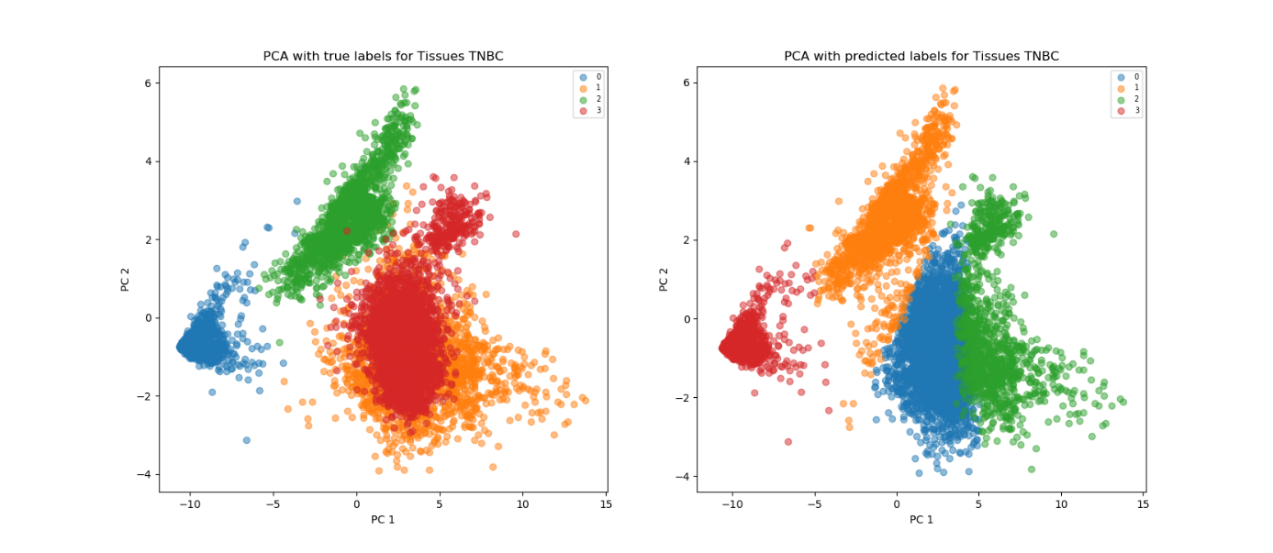
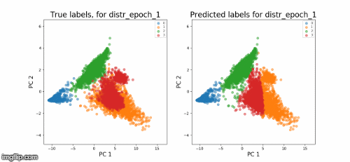
Baseline results Tissues
Baseline experiment: γ=0.1, 100 epochs
DCEC higher external metrics
Tightly packed clusters for DCEC
Overlap between lymphocytes and tumor
Naive K-means
Method, partition | NMI | ARI | ACC
Naive K-means, train | 0.70 | 0.63 | 0.82
Naive K-means, test | 0.78 | 0.86 | 0.83
DCEC, train | 0.76 | 0.70 | 0.83
DCEC, test | 0.82 | 0.90 | 0.92
DCEC

Slide 18
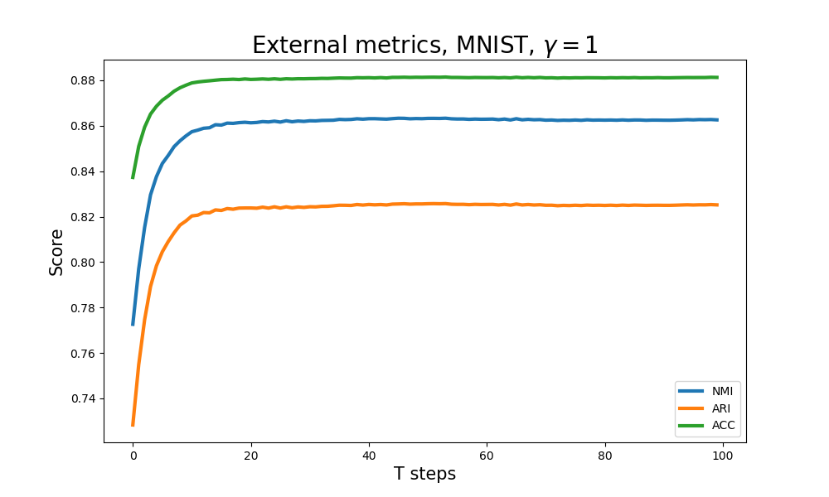
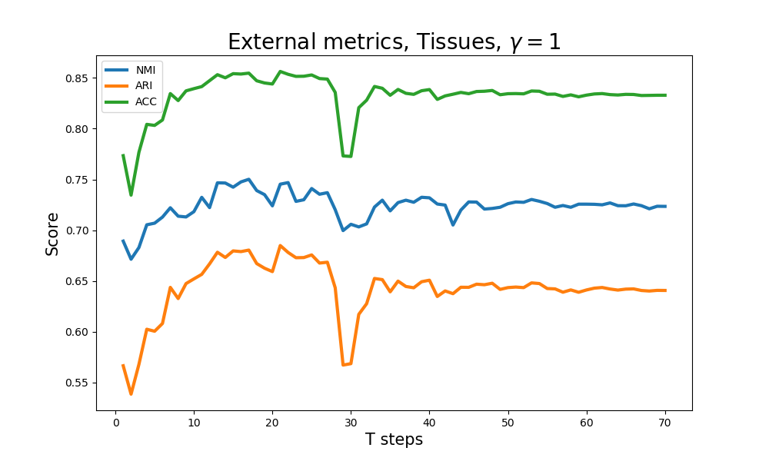
DCEC experiments vary γ
How does γ affect clustering?
T: Update interval (# batches between Q and P updates)
MNIST DCEC improves to better metrics.
Similar results for γ values
γ | NMI | ARI | ACC
0.1 | 0.87 | 0.83 | 0.88
0.4 | 0.86 | 0.83 | 0.88
0.6 | 0.86 | 0.82 | 0.88
1 | 0.86 | 0.83 | 0.88
γ | NMI | ARI | ACC | Epochs
0.1 | 0.70 | 0.55 | 0.72 | 60
0.4 | 0.66 | 0.55 | 0.77 | 47
0.6 | 0.65 | 0.52 | 0.71 | 40
1 | 0.72 | 0.64 | 0.83 | 36
Tissues less stable training.
Best results for γ=1

Slide 19
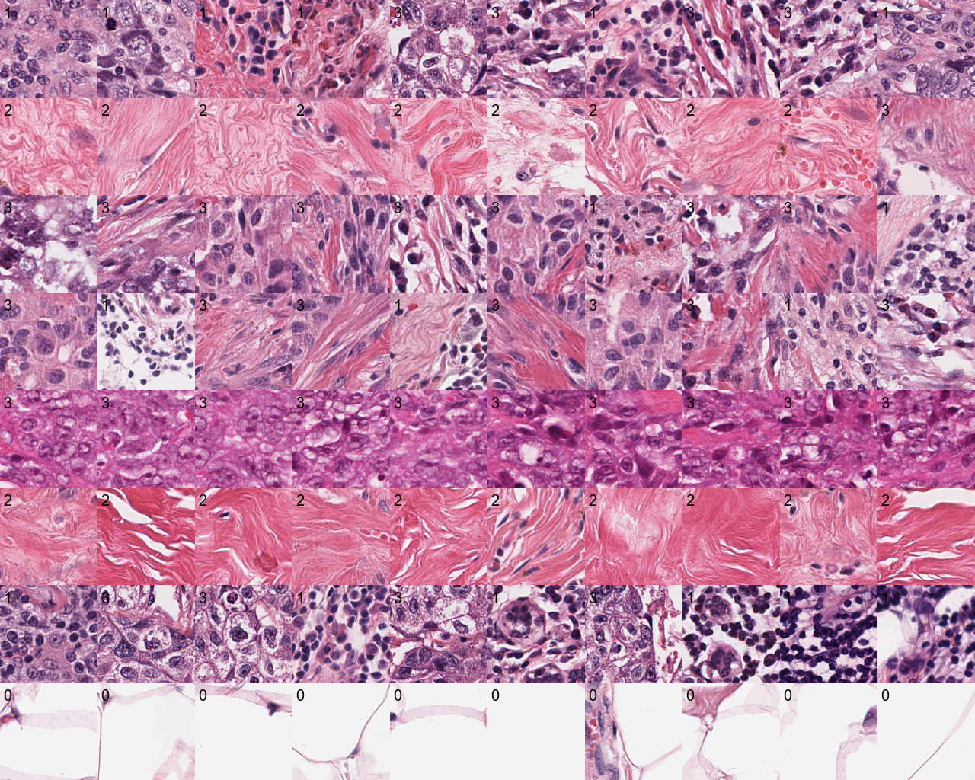
DCEC: Tissues, vary K
Does the number of clusters K reveal new subtypes?
Samples for K=8 experiment for Tissues.
Subsets to stroma groups (row 2, 6)
Stain dependency to tiles (row 5)
0
1
2
3
4
5
6
7
 | Fat | Lymphocytes | Stroma | Tumor
0 | 0 | 287 | 0 | 1158
1 | 2 | 9 | 1090 | 30
2 | 0 | 160 | 0 | 689
3 | 0 | 209 | 2 | 394
4 | 0 | 5 | 0 | 258
5 | 0 | 5 | 475 | 5
6 | 0 | 860 | 0 | 646
7 | 1562 | 0 | 1 | 0

Slide 20
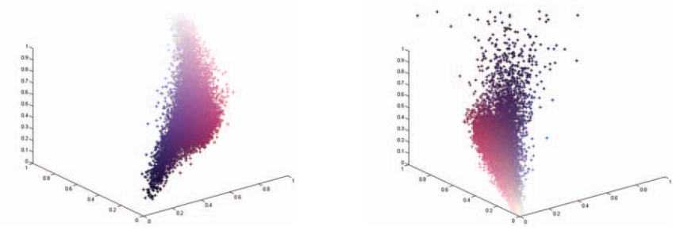
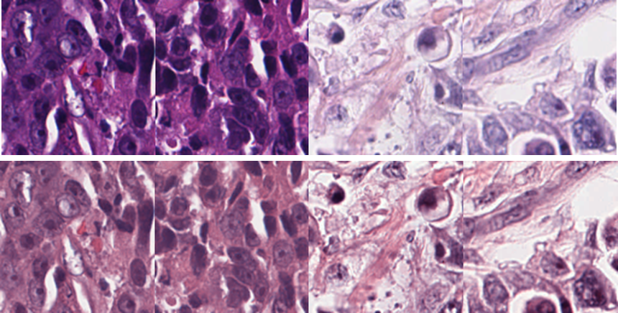
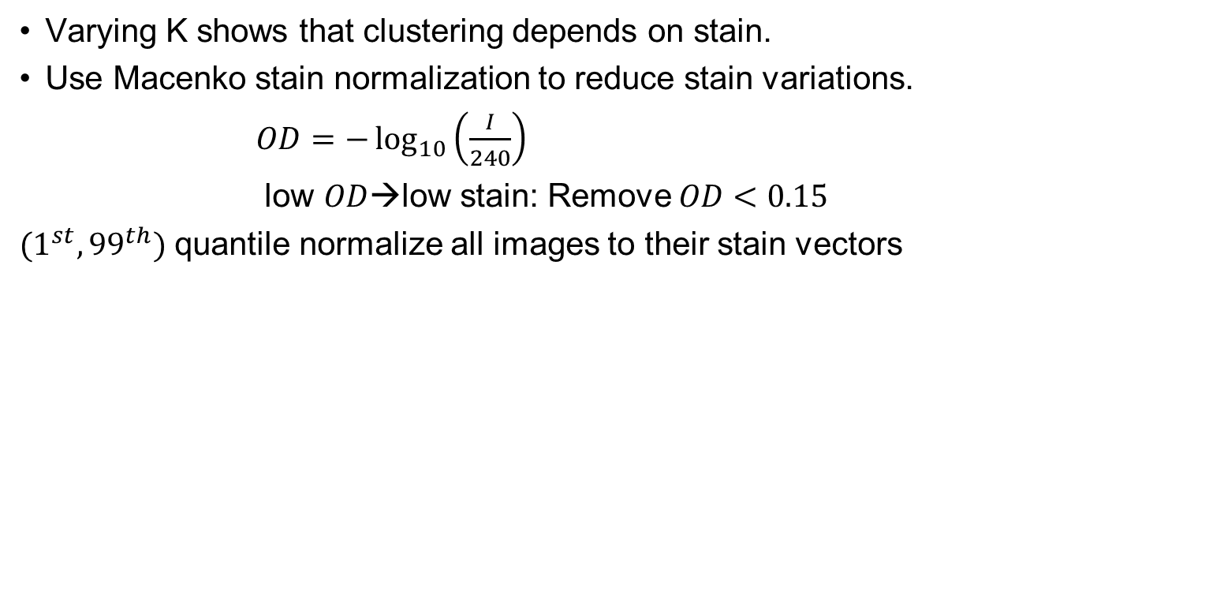
Stain normalization
Varying K shows that clustering depends on stain.
Use Macenko stain normalization to reduce stain variations.
$OD=−\log_{10}\left(\frac{I}{240}\right)$
low $OD$→low stain: Remove $OD<0.15$
$(1^{st}, {99}^{th})$ quantile normalize all images to their stain vectors
Before
After
RGB space
Curved HE
OD space
Linear HE
Macenko et al. IEEE 2009. p. 1107-1110

Slide 21
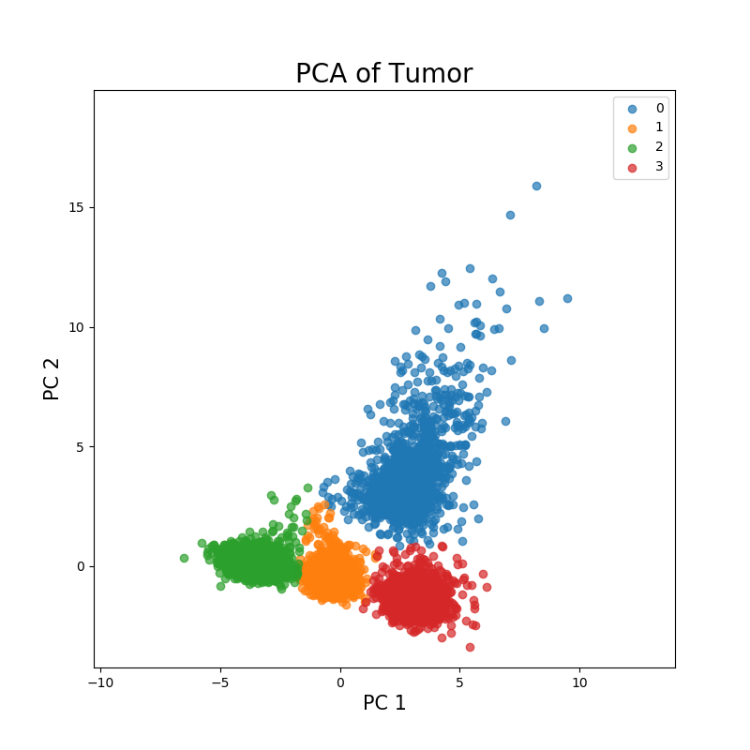
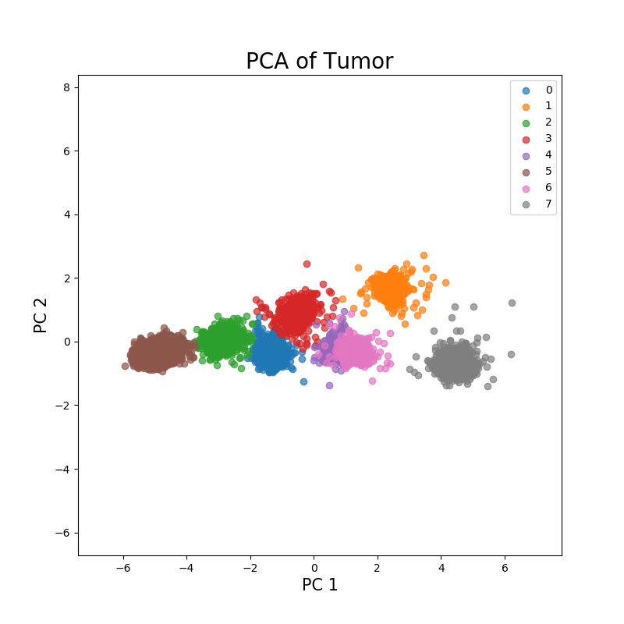
Tumor experiments
K | CHI | SSE | DBI
4 | 265781 | 0.78 | 0.29
8 | 655364 | 0.79 | 0.31
12 | 326181 | 0.77 | 0.37
Best CHI and SSE for K=8, best DBI for K=4.
γ=0.4
K=4, γ=0.4
K=8, γ=0.4
γ | CHI | SSE | DBI
0.1 | 278930 | 0.75 | 0.33
0.4 | 258890 | 0.77 | 0.30
0.6 | 330930 | 0.78 | 0.28
1 | 309260 | 0.77 | 0.29
Vary K experiment inconclusive
Final Tumor model parameters:
K=4 (higher EPV ratio)
γ=0.6 (highest internal metrics)
Better internal for higher γ.
K=4.

Slide 22
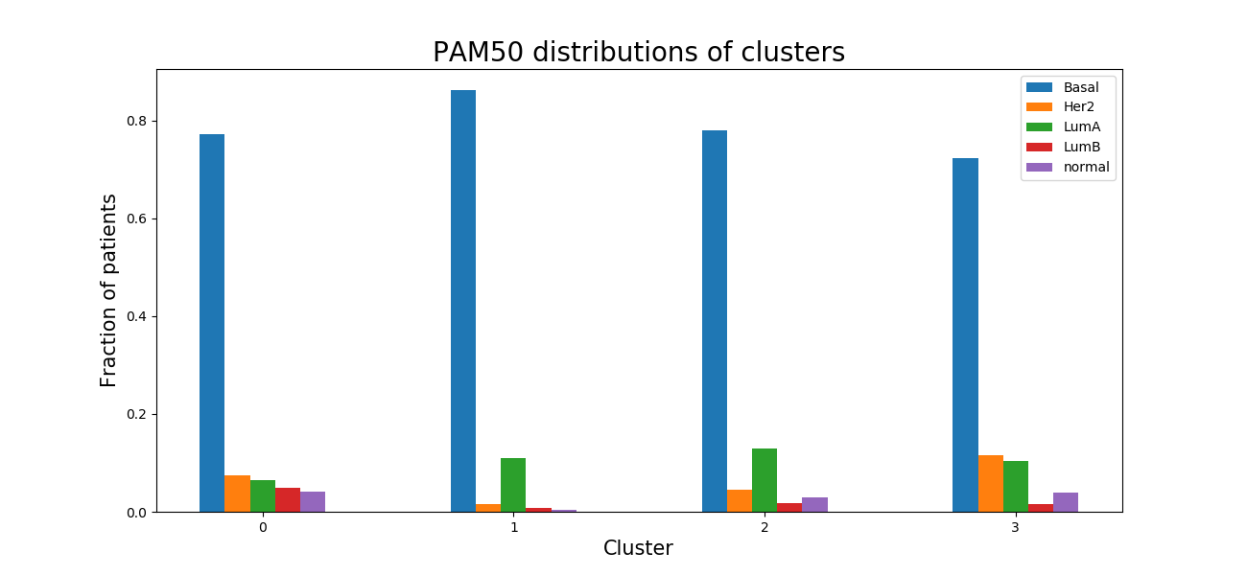
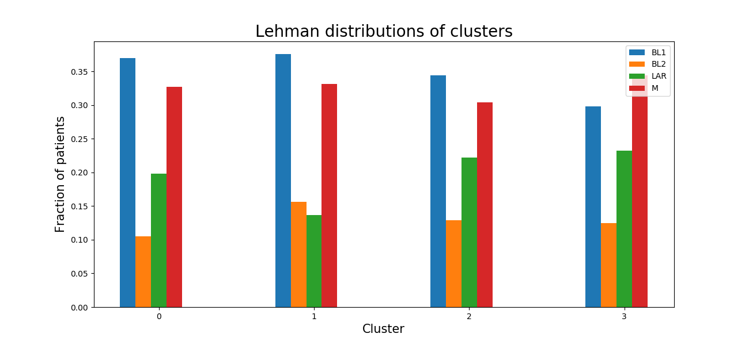
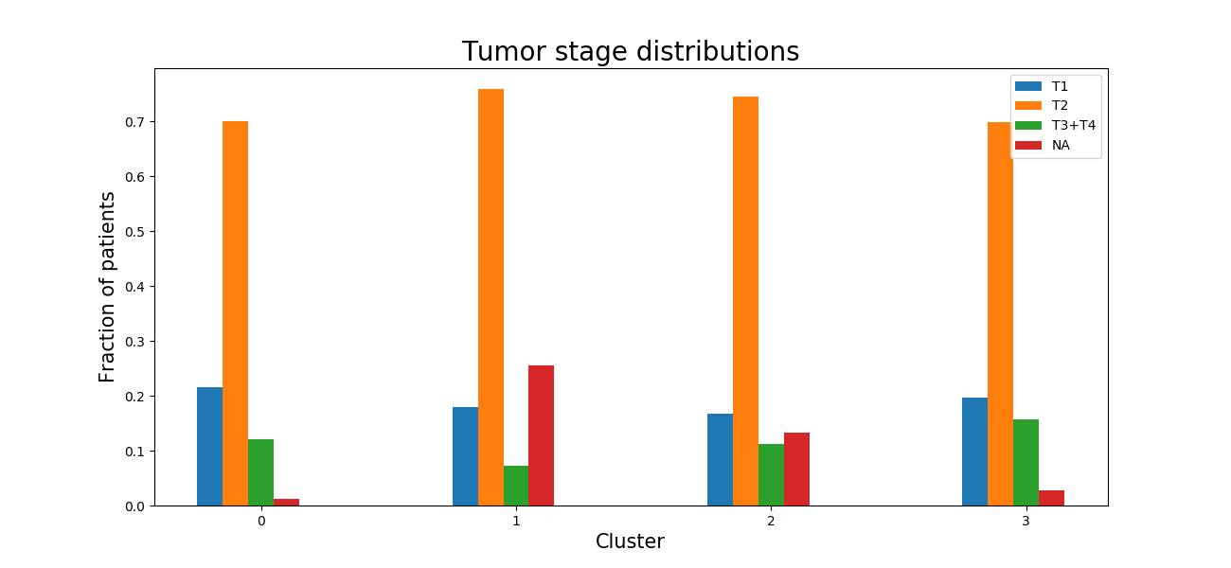
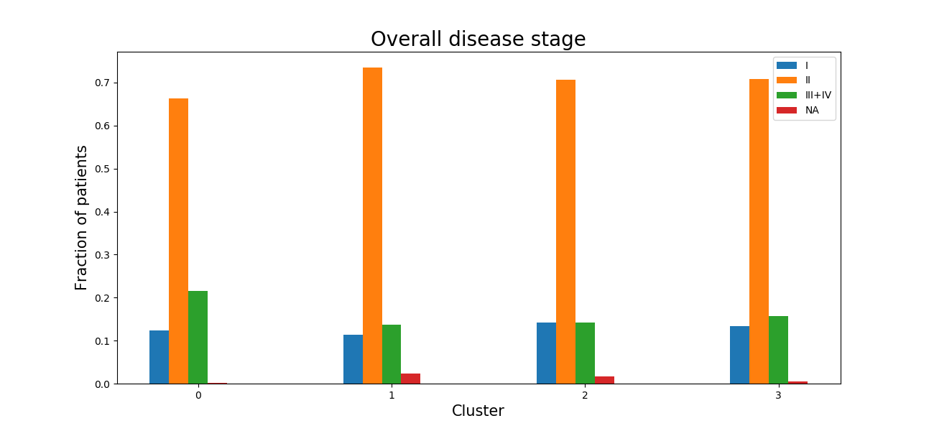
Cluster distributions

Slide 23
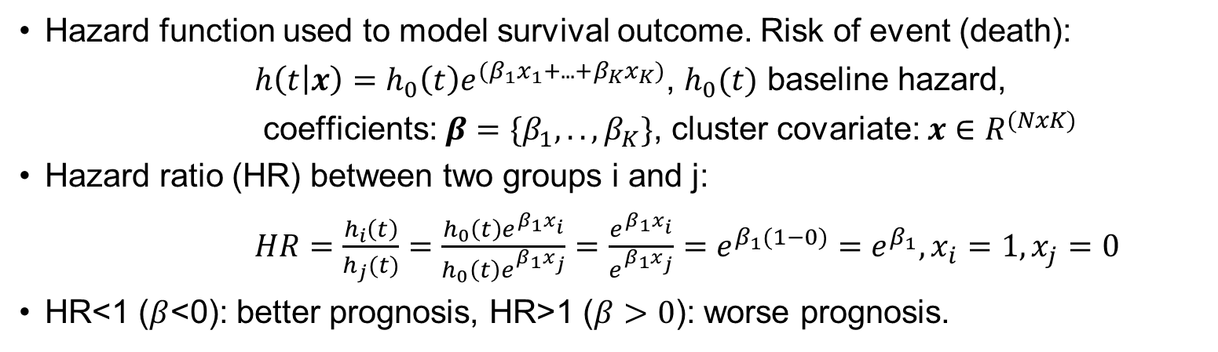
Survival analysis – cluster modelling
Hazard function used to model survival outcome. Risk of event (death):
$h\left(t | x\right)=h_{0}\left(t\right)e^{(β_{1}x_{1}+.. .+β_{K}x_{K})}$, $h_{0}(t)$ baseline hazard,
coefficients: $β=\{β_{1}, .., β_{K}\}$, cluster covariate: $x∈R^{(NxK)}$
Hazard ratio (HR) between two groups i and j:
$HR=\frac{h_{i}\left(t\right)}{h_{j}(t)}=\frac{h_{0}\left(t\right)e^{β_{1}x_{i}}}{h_{0}\left(t\right)e^{β_{1}x_{j}}}=\frac{e^{β_{1}x_{i}}}{e^{β_{1}x_{j}}}=e^{β_{1}(1−0)}=e^{β_{1}}, x_{i}=1, x_{j}=0$
HR<1 ($β$<0): better prognosis, HR>1 ($β>0$): worse prognosis.

Slide 24
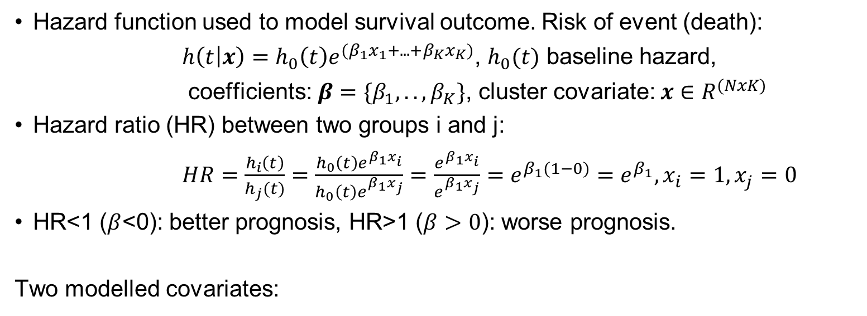
Survival analysis – cluster modelling
Hazard function used to model survival outcome. Risk of event (death):
$h\left(t | x\right)=h_{0}\left(t\right)e^{(β_{1}x_{1}+.. .+β_{K}x_{K})}$, $h_{0}(t)$ baseline hazard,
coefficients: $β=\{β_{1}, .., β_{K}\}$, cluster covariate: $x∈R^{(NxK)}$
Hazard ratio (HR) between two groups i and j:
$HR=\frac{h_{i}\left(t\right)}{h_{j}(t)}=\frac{h_{0}\left(t\right)e^{β_{1}x_{i}}}{h_{0}\left(t\right)e^{β_{1}x_{j}}}=\frac{e^{β_{1}x_{i}}}{e^{β_{1}x_{j}}}=e^{β_{1}(1−0)}=e^{β_{1}}, x_{i}=1, x_{j}=0$
HR<1 ($β$<0): better prognosis, HR>1 ($β>0$): worse prognosis.
Two modelled covariates:
Continuous
Binary

Slide 25
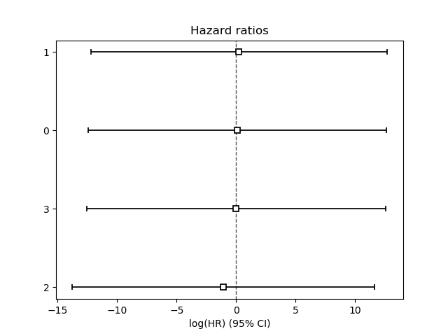
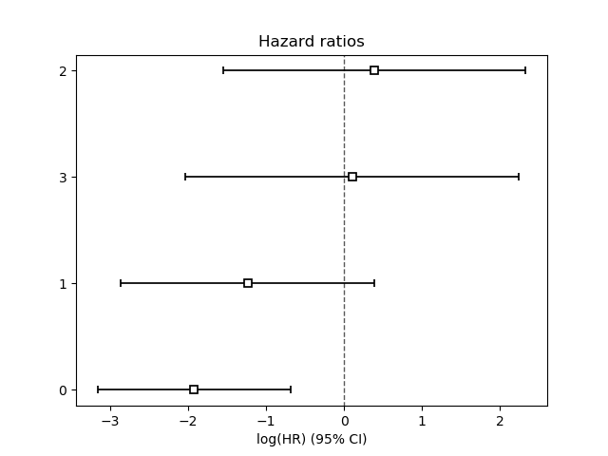
Survival outcome
Continuous covariates insignificant and highly collinear.
Binary covariates cluster 0 patients have significantly better outcome.

Slide 26
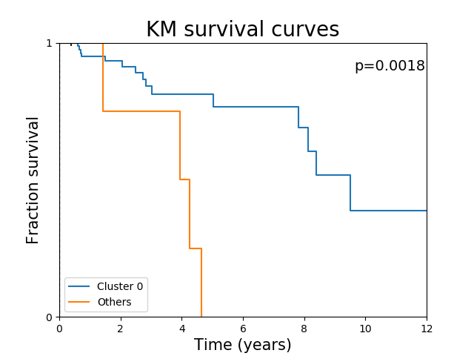
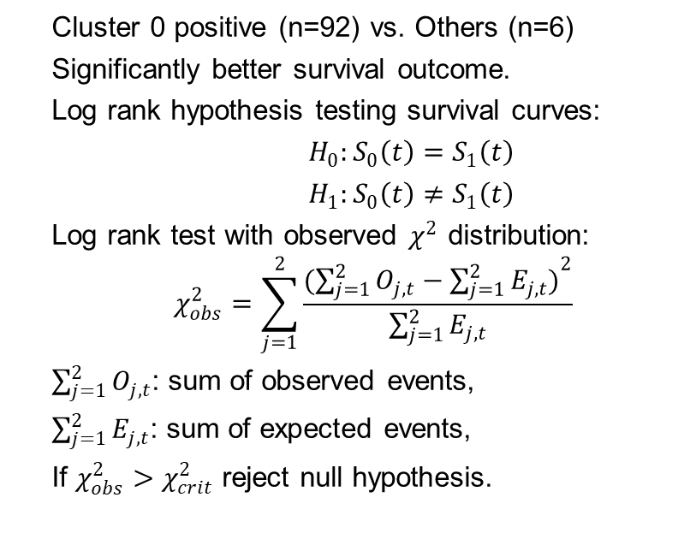
Survival curves
Cluster 0 positive (n=92) vs. Others (n=6)
Significantly better survival outcome.
Log rank hypothesis testing survival curves:
$H_{0}:S_{0}\left(t\right)=S_{1}\left(t\right)$
$H_{1}:S_{0}\left(t\right)≠S_{1}\left(t\right)$
Log rank test with observed $χ^{2}$ distribution:
$$χ_{obs}^{2}=\sum_{j=1}^{2}{\frac{(\sum_{j=1}^{2}{O_{j,t}}−{\sum_{j=1}^{2}{E_{j,t})}}^{2}}{\sum_{j=1}^{2}{E_{j,t}}}}$$
$\sum_{j=1}^{2}{O_{j,t}}$: sum of observed events,
$\sum_{j=1}^{2}{E_{j,t}}$: sum of expected events,
If $χ_{obs}^{2}>χ_{crit}^{2}$ reject null hypothesis.

Slide 27
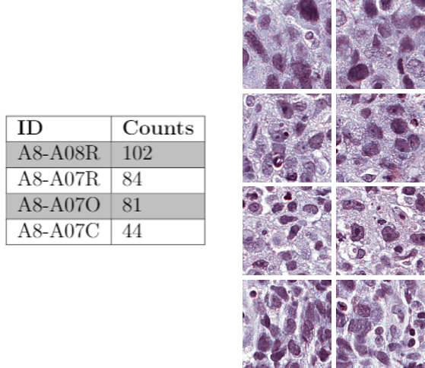

Clustering analysis – most likely tiles
The most probable (certain) cluster labels have stain residuals
Tile samples
311/400 of the most likely cluster 0 tiles
from the same A8- stained IDs

Slide 28



Future work
Vahadane stain normalization
Implement neural training more robust against stain variations
Vahadane stain normalization:
Normalize all tiles relative to a target.
Compute stain augmentations like color
Tellez et al. H and E stain augmentation improves generalization of convolutional networks for histopathological mitosis detection. 2018

Slide 29
Conclusion
DCEC is a better clustering algorithm than Naive K-means
Higher external metrics for MNIST and Tissues
Clustering the Tumors dataset shows no correlation to
PAM50, Lehmann, tumor and neoplasm stages
Binary survival modelling of cluster distributions identifies significant survival outcome.
Cluster analysis suggests stain residual from stain normalization. Clusters are confounded with stain variations.
Future work should focus on implementing networks that are more robust towards stain variations.

